Slide 1
MongoDB

Slide 2
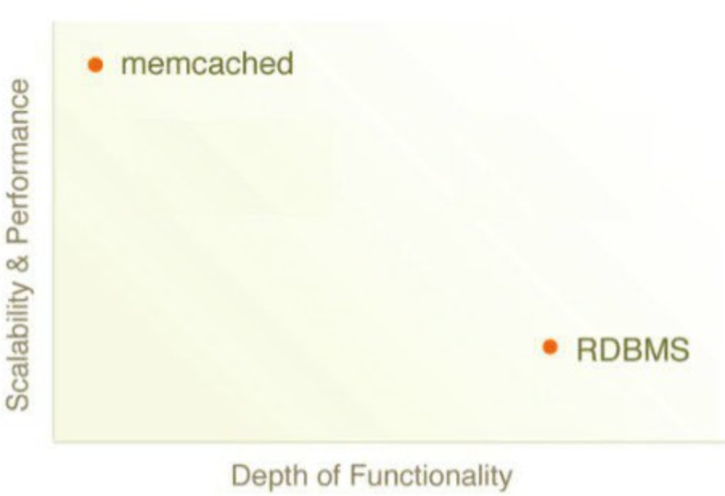
MongoDB
MongoDB - Sweet Spot: Easy, Flexible and Scalable

Slide 3
What is MongoDB ?
Scalable High-Performance Open-source, Document-orientated database.
Built for Speed
Rich Document based queries for Easy readability
Full Index Support for High Performance
Replication and Failover for High Availability
Auto Sharding for Easy Scalability
Map / Reduce for Aggregation.

Slide 4
Why use MongoDB?
SQL was invented in the 70’s to store data.
MongoDB stores documents (or) objects.
Now-a-days, everyone works with objects
(C#,Python,Ruby,Java,etc.)
And we need Databases to persist our objects.
Then why not store objects directly ?
Embedded documents and arrays reduce need for joins.
No Joins and No-multi document transactions.

Slide 5
What is MongoDB great for?
RDBMS replacement for Web Applications
Semi-structured Content Management
Real-time Analytics & High-Speed Logging
Caching and High Scalability
Web 2.0, Media, SAAS, Gaming
HealthCare, Finance, Telecom, Government

Slide 6
What is MongoDB NOT great for?
Highly Transactional Applications
Problems requiring SQL

Slide 7

Companies using MongoDB in Production

Slide 8
Glossary
When I say Database Think Database
Made up of Multiple Collections
Created on-the-fly when referenced for the first time
When I say Collection Think Table
Schema-less, and contains Documents
Indexable by one/more keys
Created on-the-fly when referenced for the first time
Capped Collections: Fixed size, older records get dropped after reaching the limit
When I say Document Think Record/Row
Stored in a Collection
Can have _id key – works like Primary keys in MySQL
Supported Relationships – Embedded (or) References
Document storage in BSON (Binary form of JSON)

Slide 9
Understanding the Document Model
var p = {
‘_id’: ‘3432’,
‘author’: DBRef(‘User’, 2),
‘title’: ‘Introduction to MongoDB’,
‘body’: ‘MongoDB is an open sources.. ‘,
‘timestamp’: Date(’01-04-12’),
‘tags’: [‘MongoDB’, ‘NoSQL’],
‘comments’: [{‘author’: DBRef(‘User’, 4),
‘date’: Date(’02-04-12’),
‘text’: ‘Did you see.. ‘,
‘upvotes’: 7, … ]
}
> db.posts.save(p);

Slide 10
Secondary Indexes
Create Index on any field in the document
// 1 means ascending, -1 means descending
> db.posts.ensureIndex({‘author’: 1});
//Index Nested Documents
> db.posts.ensureIndex(‘comments.author’: 1);
// Index on tags
> db.posts.ensureIndex({‘tags’: 1});
// Geo-spatial Index
> db.posts.ensureIndex({‘author.location’: ‘2d’});

Slide 11
What about Queries? So Simple
// find posts which has ‘MongoDB’ tag. > db.posts.find({tags: ‘MongoDB’}); // find posts by author’s comments. > db.posts.find({‘comments.author’: DBRef(‘User’,2)}).count(); // find posts written after 31st March. > db.posts.find({‘timestamp’: {‘gte’: Date(’31-03-12’)}}); // find posts written by authors around [22, 42] > db.posts.find({‘author.location’: {‘near’:[22, 42]}); What about Queries? So Simple $gt, $lt, $gte, $lte, $ne, $all, $in, $nin, count, limit, skip, group, etc…

Slide 12
What about Updates? Atomic Operations makes it simple
db.posts.update({_id: ‘3432’},
{‘title’: ‘Introduction to MongoDB (updated)’,
‘text’: ‘Updated text’,
${addToSet: {‘tags’: ‘webinar’}});
What about Updates? Atomic Operations makes it simple
$set, $unset
Where are my joins and transactions? !!!
$push, $pull, $pop, $addToSet
$inc, $decr, many more…
Where are my joins and transactions? !!!

Slide 13
Some Cool features
Geo-spatial Indexes for Geo-spatial queries.
$near, $within_distance, Bound queries (circle, box)
GridFS
Stores Large Binary Files.
Map/Reduce
GROUP BY in SQL, map/reduce in MongoDB.

Slide 14
Rerences
https://www.slideshare.net/raviteja2007/introduction-to-mongodb-12246792
https://docs.mongodb.com/

